Slide 1
Semantic Versioning
A Software Release Numbering System

Slide 2
Semantic Versioning
Given a version number MAJOR.MINOR.PATCH, increment the:
MAJOR version when you make incompatible API changes
MINOR version when you add functionality in a backwards- compatible manner
PATCH version when you make backwards-compatible bug fixes
Additional labels for pre-release and build metadata are available as extensions to the MAJOR.MINOR.PATCH format.

Slide 3
The Numbers
1.2 .6
Major version
Patch
Minor version

Slide 4
The Numbers
8 .2 .6
Major version
Major changes Breaks the API
Patch
Minor version

Slide 5
The Numbers
1. 2 .6
Major version
Major changes Breaks the API
Patch
Minor version
New features
Does not break API

Slide 6
The Numbers
1.2 .6
Major version
Major changes Breaks the API
Patch
Bug fixes
Minor version
New features
Does not break API

Slide 7
The Numbers
1.2 .6
Major version
Major changes Breaks the API
Patch
Bug fixes
Minor version
New features
Does not break API

Slide 8
Bug Fix
1.2.7

Slide 9
New Feature
1.3.0

Slide 10
Breaking the API
2.0.0

Slide 11
Pre-release Versioning
Initial development uses Major version 0 (e.g. 0.1.0)
You may use pre-release strings (e.g. alpha1, rc3, etc.)
These are appended to the end (e.g. 1.0.0.alpha1)
A publicly-released API starts at 1.0.0

Slide 12
Benefits of Semantic Versioning
Clearer compatibility/dependencies
Encourages well-defined APIs
Makes upgrade decisions clearer

Slide 13
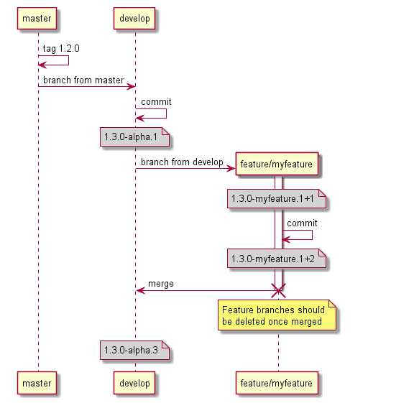
GitFlow Examples
Feature Branches
Feature branches will take the feature branch name and use that as the pre-release tag.
Notes:
Notice after the feature branch is merged, the version on develop is 1.3.0-alpha.3. This is due to develop running in continuous deployment mode. If you configured develop to use continuous delivery the version would still be 1.3.0-alpha.1 and you would have to use release tags to increment the alpha.1.

Slide 14
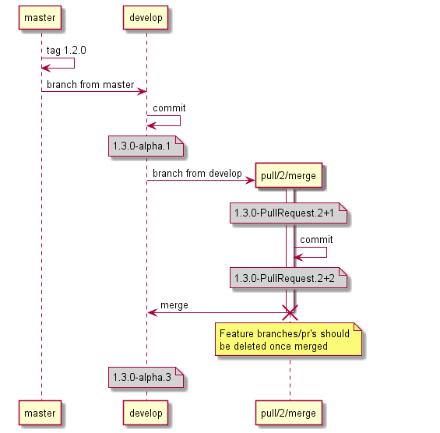
Pull Request
Because feature branches are most likely pushed to a fork, we are showing the pull request branch name which is created when submit a pull request.

Slide 15
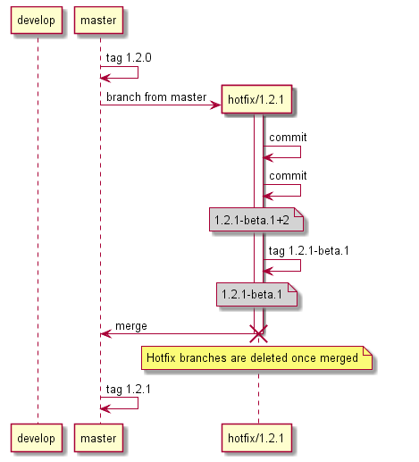
Hotfix Branches
Hotfix branches are used when you need to do a patch release in GitFlow and are always created off master

Slide 16
Minor Release Branches
Release branches are used for both major and minor releases for stabilization before a release. Release branches are taken off develop then merged to both develop and master. Finally master is tagged with the released version.

Slide 17
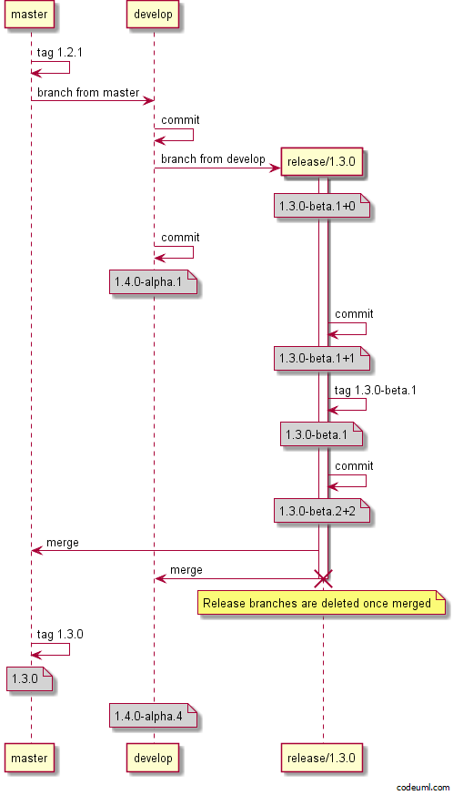

Slide 18
Major Release Branches
Major releases are just like minor releases, the difference is you bump the major in the release branch name.

Slide 19
